Slide 1
Mechanistic insights into the R-loop formation and cleavage in CRISPR-Cas12i1
12111419 李政林
2023.06.25

Slide 2
How to unwind? & How to stabilize?

Slide 3
Contents
The sequential cis-cleavage of the NTD and TD strands
Background
Overall architectures of two ternary complexes of Cas12i1.
A loop region in the Helical-II domain facilitates the TD strand loading into the RuvC active site
Recognition of the crRNA repeat region
Base pairings within the seed region mimicking the target interrogation
Mechanism of the 5′-TTN-3′ PAM determination
Target binding activates the Cas12i1 DNase activity
Mechanism of the R-loop formation in Cas12i1
Discussion
Methods

Slide 4
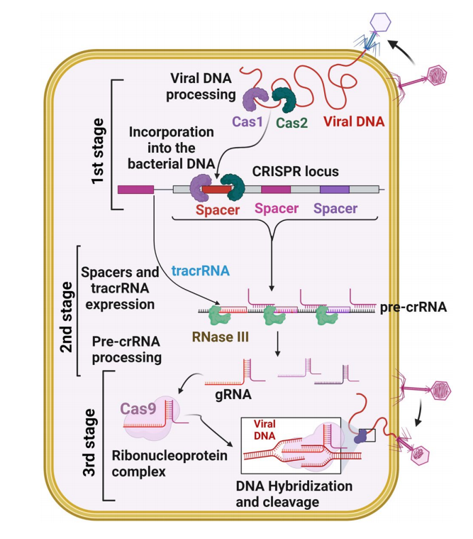
Background
CRISPR–Cas12i system (class 2, type V-i)
CRISPER/Cas system use CRISPR RNA (crRNA) to recognize foreign double-stranded DNA (dsDNA) , both protein families must bind to a protospacer adjacent motif (PAM), a short DNA sequence, to prevent autoimmunity
Hillary, V. E., & Ceasar, S. A., 2023.

Slide 5
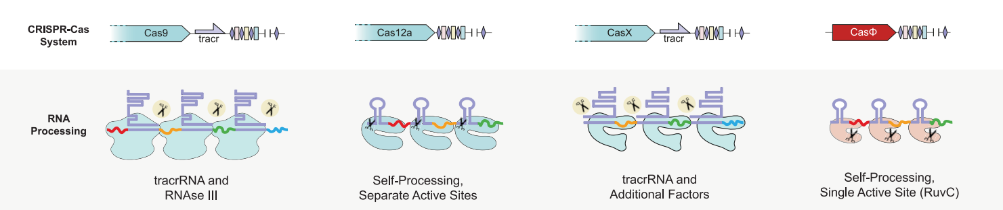
Background
Conventional Cas proteins (such as Cas 9) require tracer RNA guidance, but Cas 12 does not
Cas 12 can process crRNA itself
Pausch, P. et al, 2020

Slide 6
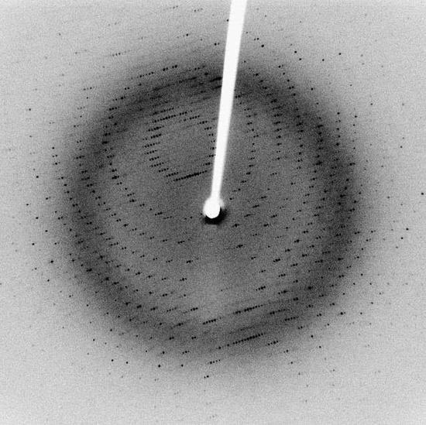
Single-wavelength anomalous diffraction method
When a detector records an X-ray diffraction pattern, it is able to detect intensity, but not phase

Slide 7
Single-wavelength anomalous diffraction method
Background
When there are unrelated structures, there are two other ways to evaluate the phase. Two of these methods are related to X-ray crystallography: multiwavelength anomalous diffraction (MAD), single-wavelength anomalous diffraction (SAD, 单波长异常衍射), which uses only one wavelength of X-rays
Selenium(硒), which is heavier than atoms normally found in proteins such as carbon, nitrogen and oxygen, absorbs X-rays and emits them again through element-specific resonance. From this resonance diffraction data, the scientists were able to determine the phase

Slide 8
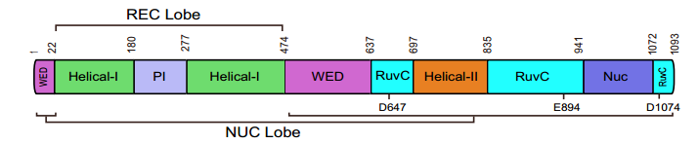
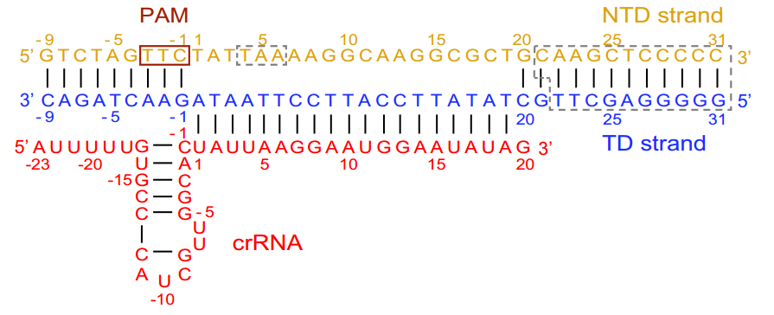
Overall architectures of two ternary complexes of Cas12i1
Recognition (REC) lobe
Nuclease (NUC) lobe
PAM-interacting (PI) domain
Wedge (WED) domain
RuvC, and Nuc domains
A mature 43-nt crRNA consisting of 23-nt repeat region and 20-nt guide region

Slide 9
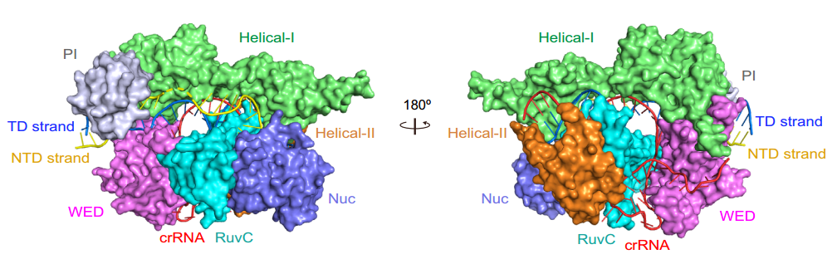
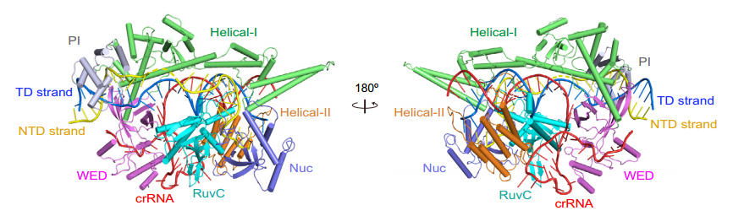
Overall architectures of two ternary complexes of Cas12i1
Recognition (REC) lobe
Nuclease (NUC) lobe
PAM-interacting (PI) domain
Wedge (WED) domain
RuvC, and Nuc domains

Slide 10
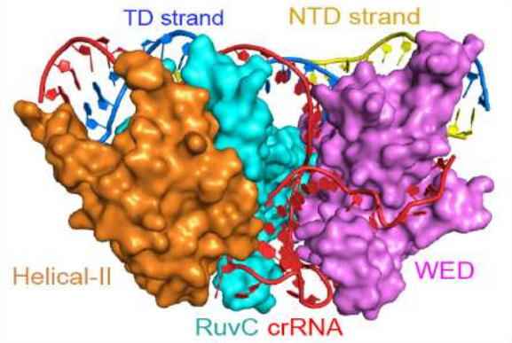
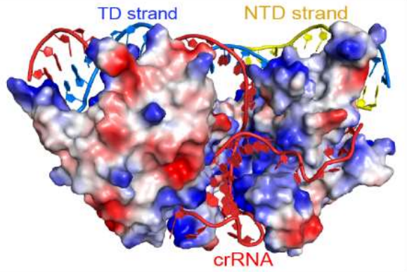
Recognition of the crRNA repeat region
stabilizing the sugarphosphate backbone of the stem-loop structure

Slide 11
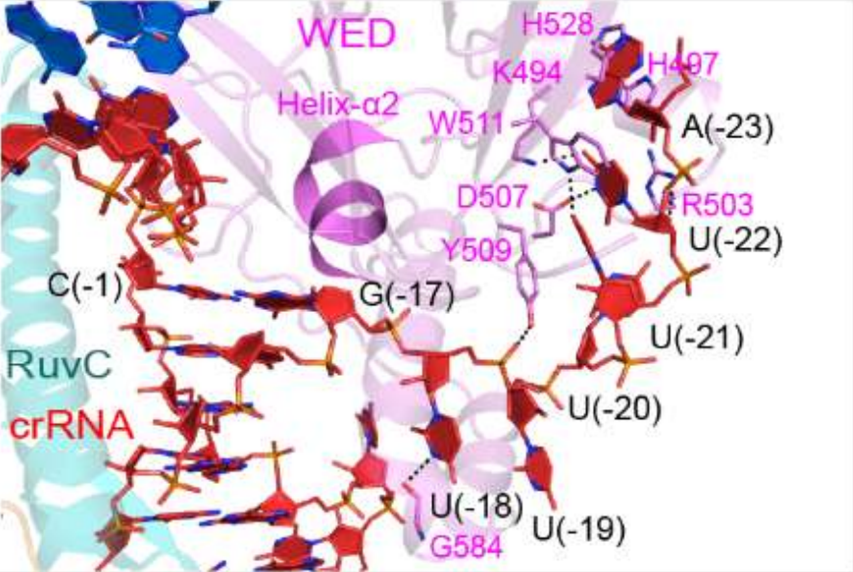
Recognition of the crRNA repeat region
The short helix α2 of the WED domain is located above the G(−17):C(−1) base pair of the stem duplex, which markedly distorts orientations of the nucleotides

Slide 12
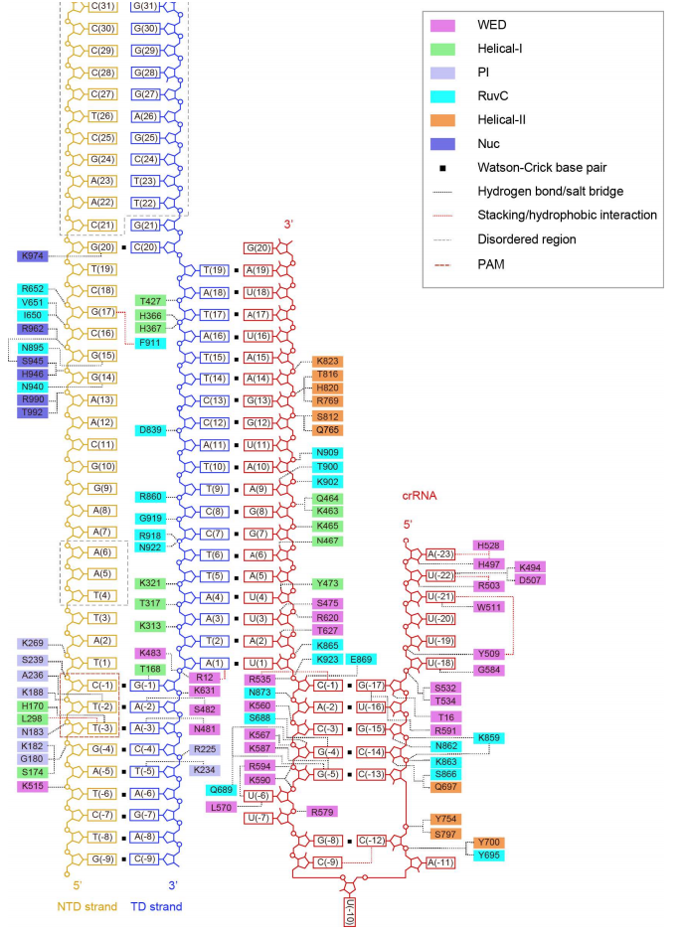

Slide 13
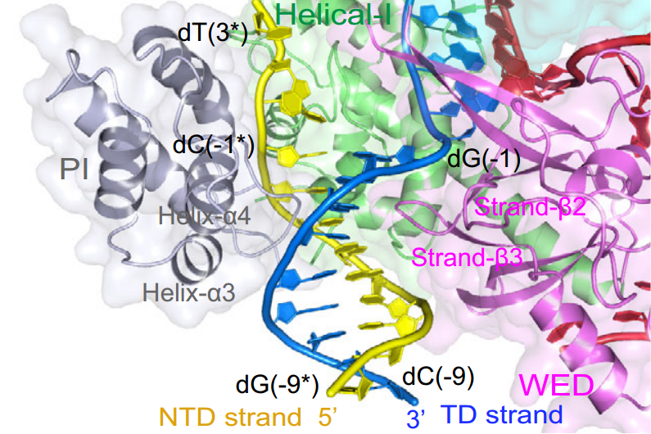
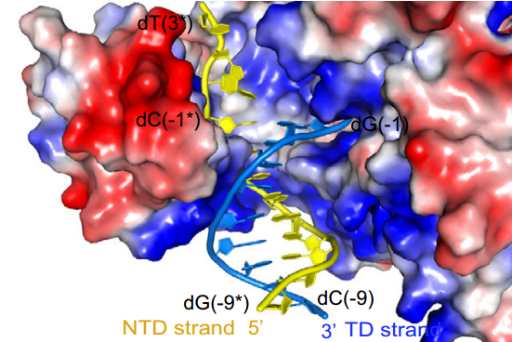
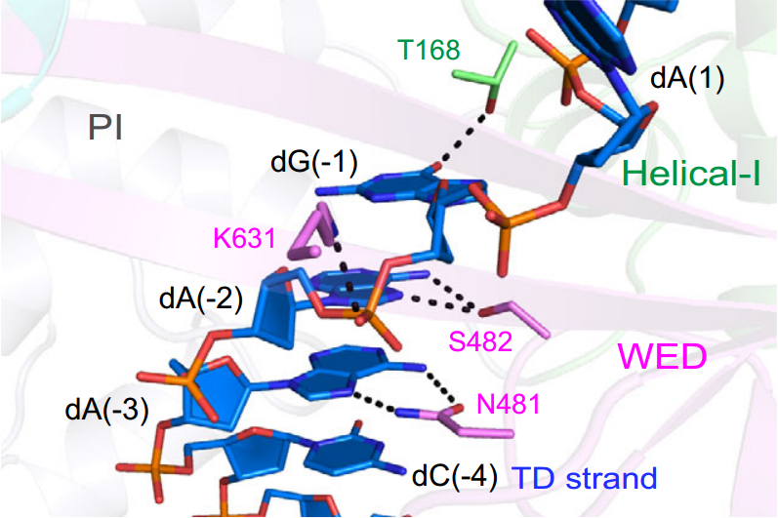
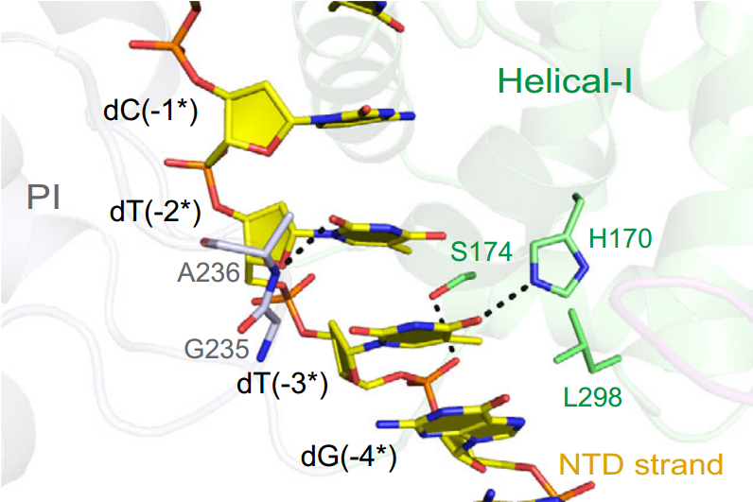
Mechanism of the 5′-TTN-3′ PAM determination
In pre-cleavage R-loop complex, a loop between the helices α3 and α4 of the PI domain inserts into the minor groove of the PAM duplex to contact the PAM nucleotides dT (−3*) and dT(−2*) in the NTD strand

Slide 14
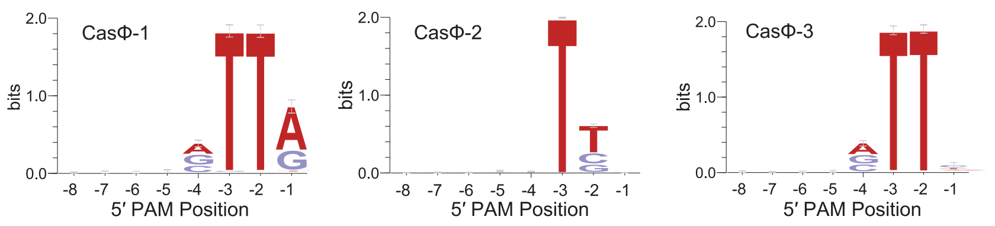
Mechanism of the 5′-TTN-3′ PAM determination
Pausch, P. et al, 2020

Slide 15
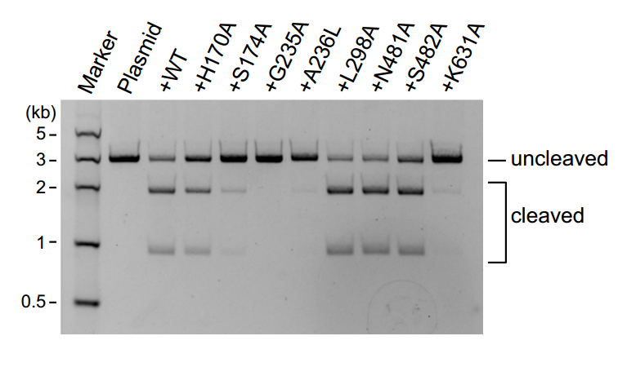
Mechanism of the 5′-TTN-3′ PAM determination
Other structure: The results of the cleavage assays show that the previously unreported G235A and A236L mutations almost abolished the cleavage activity. The S174A and K631A mutations decrease this activity

Slide 16
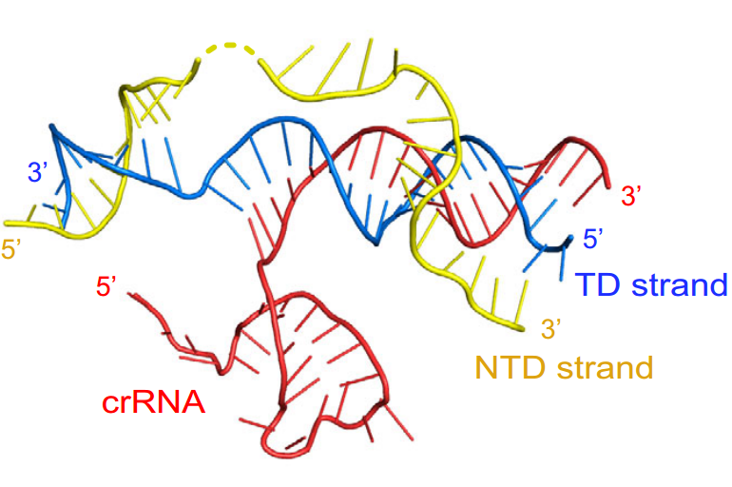
Mechanism of the R-loop formation in Cas12i1

Slide 17
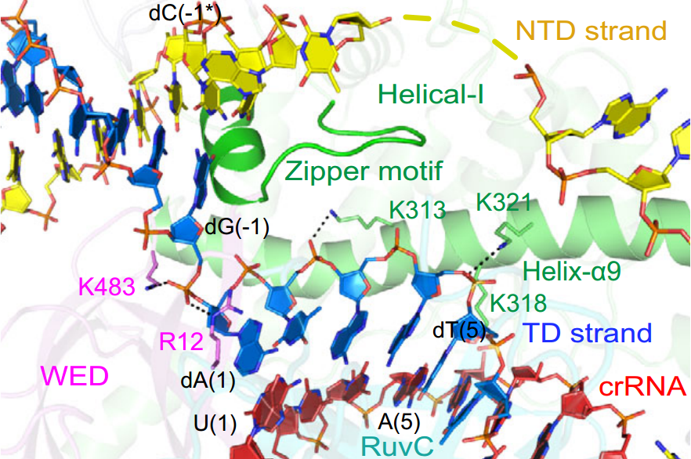
Mechanism of the R-loop formation in Cas12i1
helix α7 and a loop region between helices α6 and α7 of the Helical-I domain are positioned to obstruct the possible base pairings and prompt the flipping of dA(1)–dA(3), thus behaving as a “zipper” for unwinding of the target DNA duplex, and are henceforth referred to as the zipper motif

Slide 18
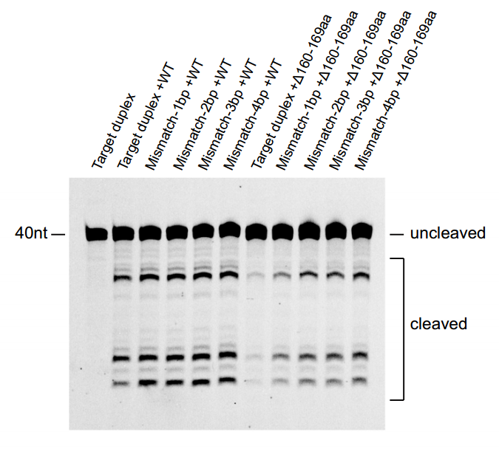
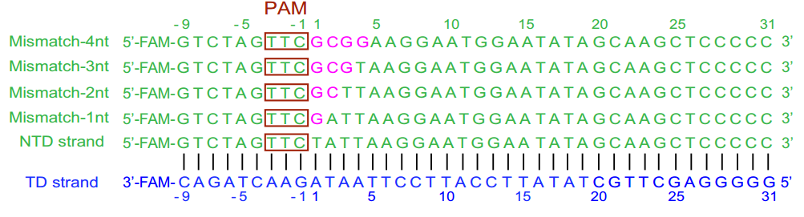
Mechanism of the R-loop formation in Cas12i1
To investigate the function of the zipper motif, they generated a protein construct in which the loop region (residues K160–A169) of the zipper motif was replaced by a simple linker (residues GGSGGS)

Slide 19
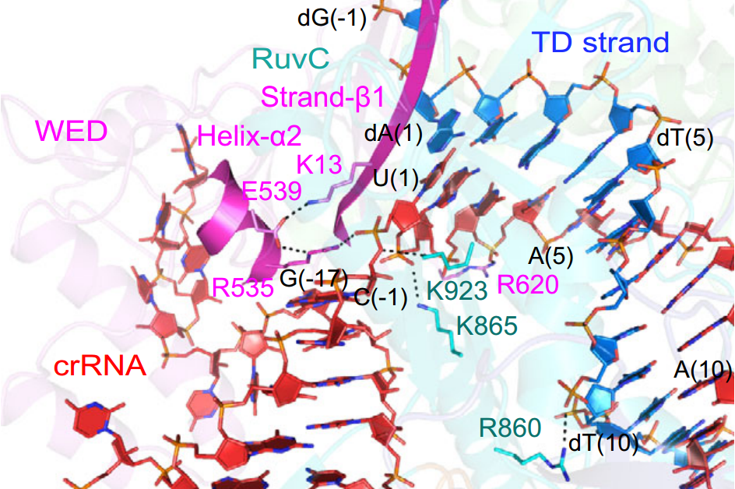
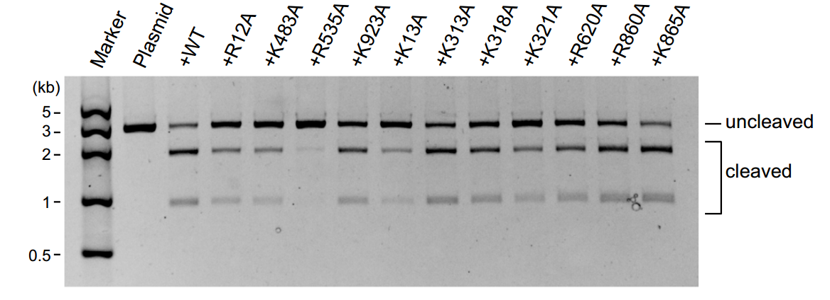
Mechanism of the R-loop formation in Cas12i1
They mediate a flipping of the nucleotide in the crRNA and facilitate base pairing with TD strand.
Residues R535 and K923 form salt bridges with the phosphate group between U(1) and C(−1), which profoundly shapes the orientation of U(1) in the crRNA. Residues R535 and K13 interact with E539 to further stabilize the orientation of U(1).

Slide 20
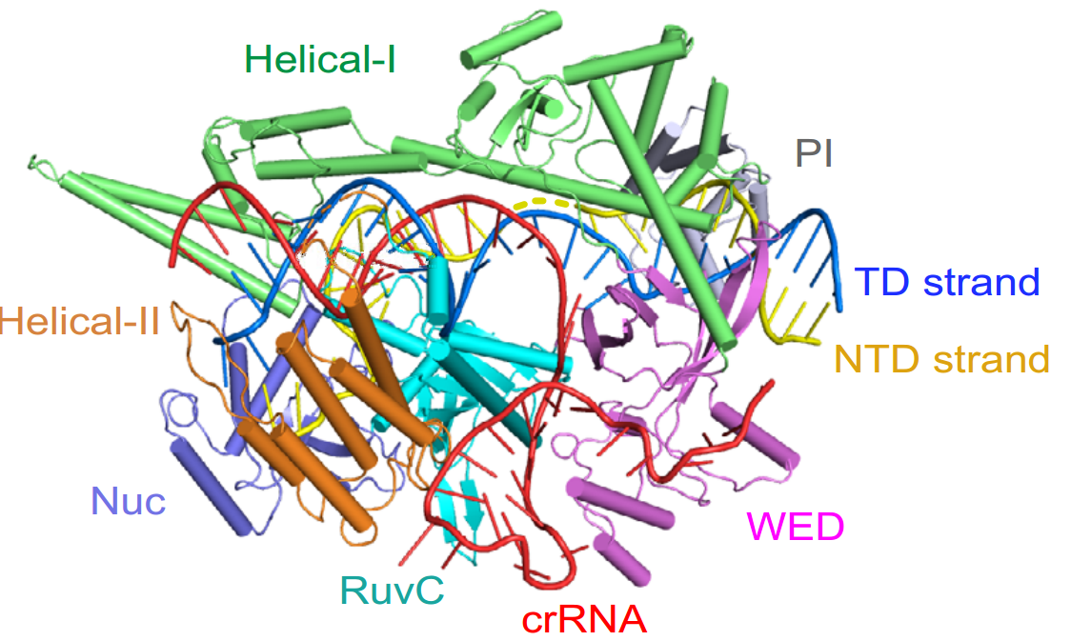
Mechanism of the R-loop formation in Cas12i1
α9
The crRNA guide-TD strand heteroduplex is flanked by
Cas12i1 on both sides throughout its length

Slide 21
Mechanism of the R-loop formation in Cas12i1
The crRNA guide - TD strand heteroduplex is flanked by Cas12i1 on both sides throughout its length
The heteroduplex-binding channel is formed by the Helical-I, Helical-II, and RuvC domains,

Slide 22
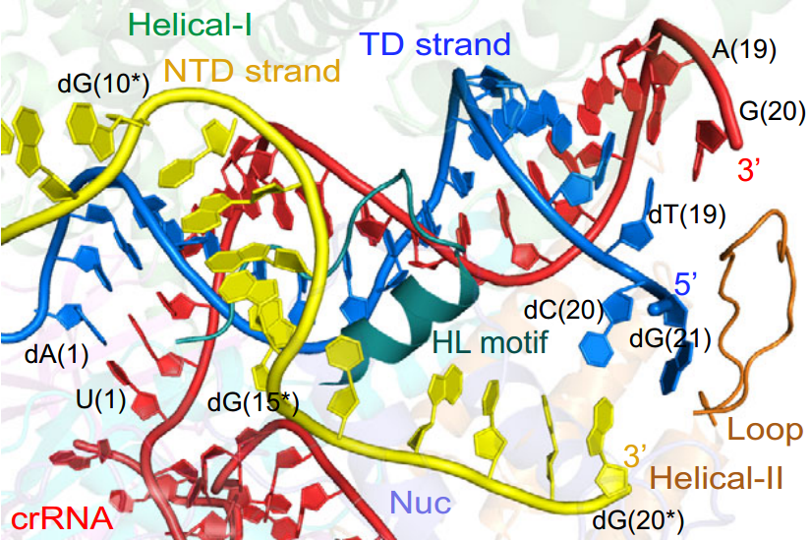
Mechanism of the R-loop formation in Cas12i1
On the other flank of the heteroduplex, a helix-loop (HL) motif (residues N895-W915) in the RuvC domain acts as a guardrail that restricts the unpaired region of the NTD strand and the heteroduplex to two separate channels
the NTD strand-binding channel is formed by the Helical-I, Helical-II,RuvC, and Nuc domains. Single mutations to alanine of residues

Slide 23
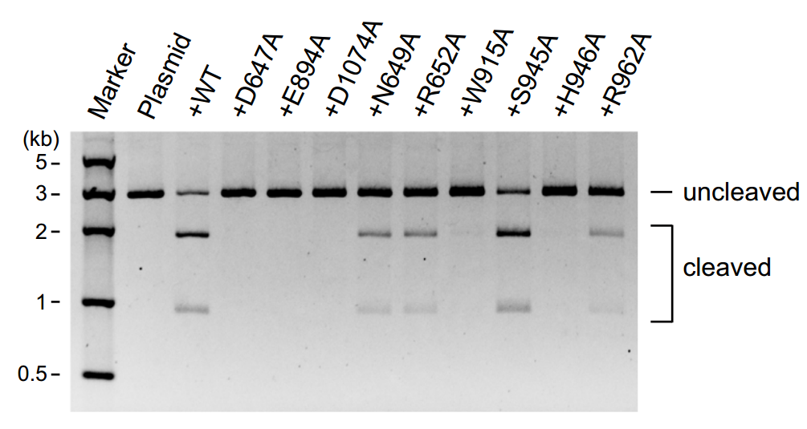
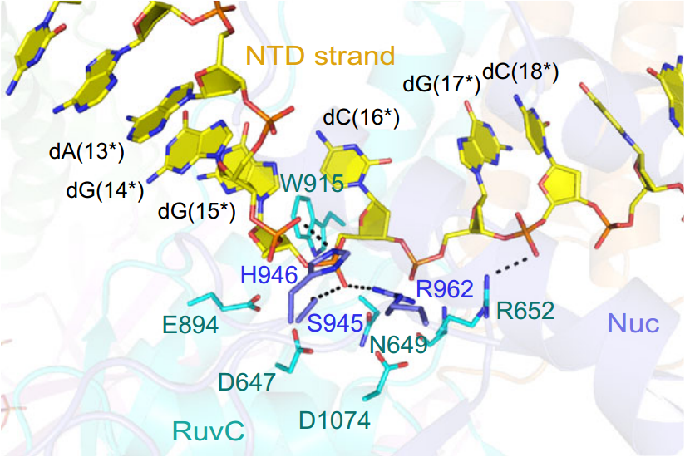
Mechanism of the R-loop formation in Cas12i1
W915 and H946 work together to restrict the sugar-phosphate backbone of the NTD strand passing through the RuvC active site. Side chains of three catalytic residues D647 (virtual modeling of A647D), E894, and D1074 in the RuvC domain point toward the phosphate group between the nucleotides dG(15*) and dC(16*), implying this position as the possible cutting site in the NTD strand

Slide 24
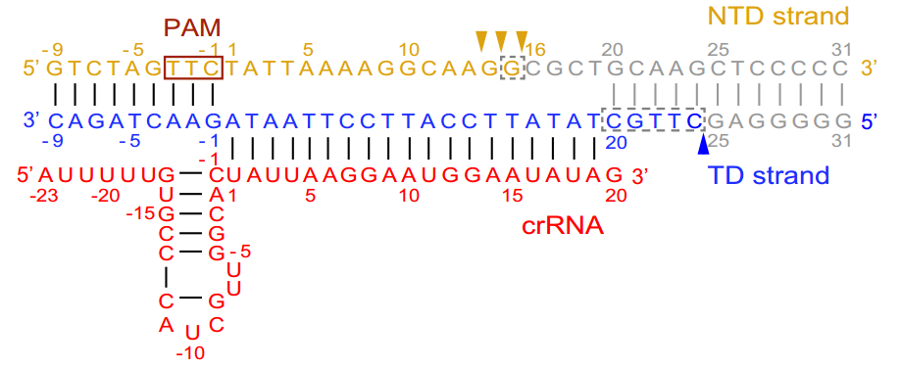
The sequential cis-cleavage of the NTD and TD strands
We called the promiscuous cleavage of collateral ssDNAs transcleavage to distinguish it from the programmable on-target cleavage of target ssDNA (namely, cis-cleavage)

Slide 25
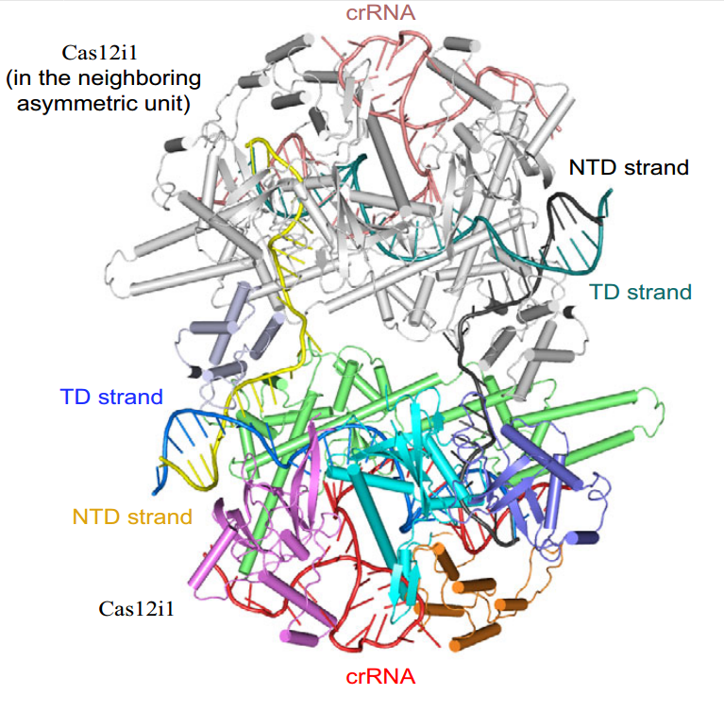
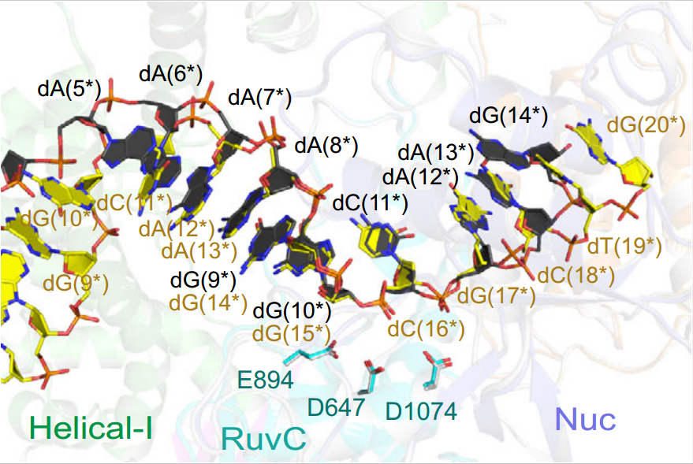
The sequential cis-cleavage of the NTD and TD strands
Interestingly, the cleaved NTD strand stretches out of Cas12i1 and is captured by the neighboring complex from another asymmetric unit

Slide 26
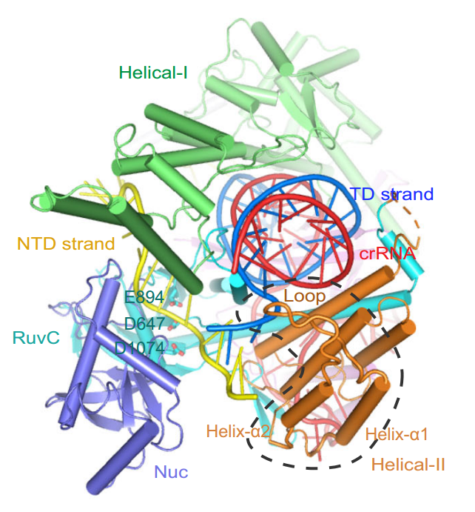
A loop region in the Helical-II domain facilitates the TD
strand loading into the RuvC active site.
the mechanism of the TD strand loading into the RuvC active site for cleavage remains to be clarified
In the pre-cleavage R-loop complex, a loop region in the Helical-II domain facilitates bending of the 5′-terminal of the TD strand toward the Nuc domain, in which the TD strand interacts again with the NTD strand

Slide 27
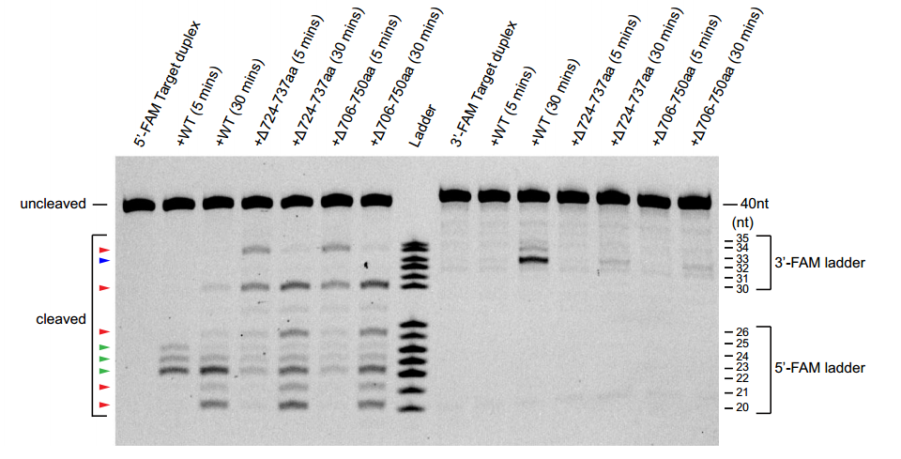
A loop region in the Helical-II domain facilitates the TD
strand loading into the RuvC active site.
Left: NTD
Right: TD
They substituted this loop region (residues N724–I737) or the region containing this loop and two flanking helices (residues L706–E750) with a linker (residues GGSG)

Slide 28
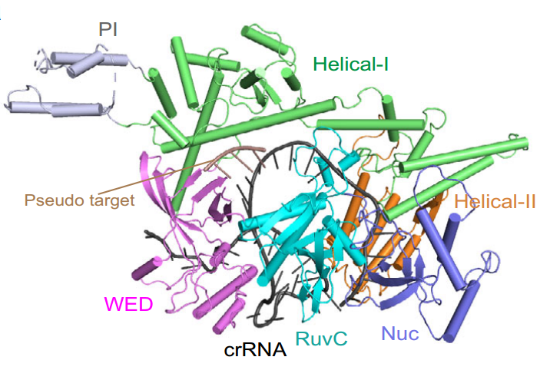
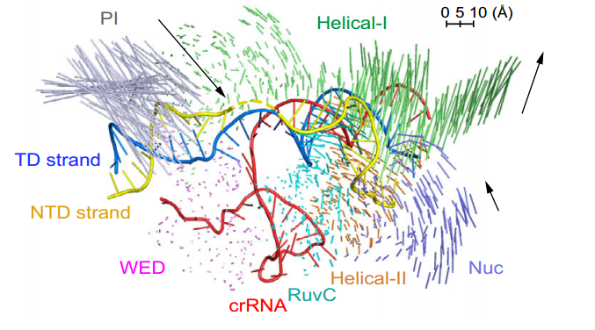
Base pairings within the seed region mimicking
the target interrogation
The global structure of Cas12i1 in the binary complex also exhibits the bilobed architecture, and the crRNA repeat region is recognized by Cas12i1 in the manner observed in the R-loop complexes

Slide 29
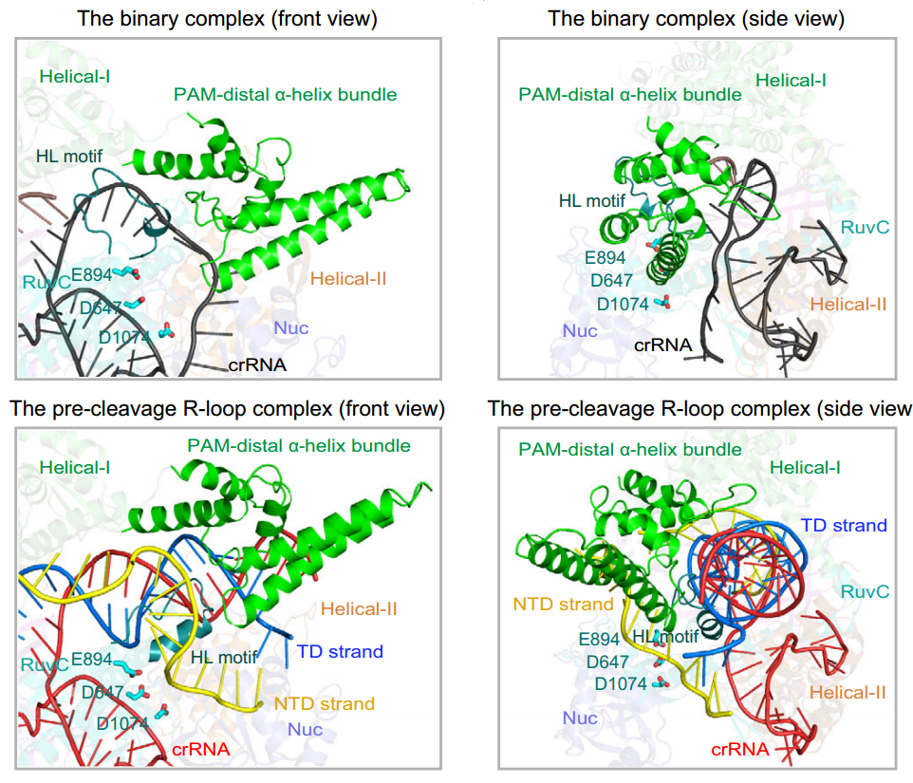
Target binding activates the Cas12i1 DNase activity
An overlay of the binary and ternary complexes reveals that the PAM-interacting cleft undergoes an “open to closed” conformational transition to clench the PAM duplex
The HL motif of the RuvC domain swings. The PAM-distal α-helix bundle and the HL motif no longer obstruct the RuvC active site and the DNase activity of Cas12i1 is unleashed

Slide 30
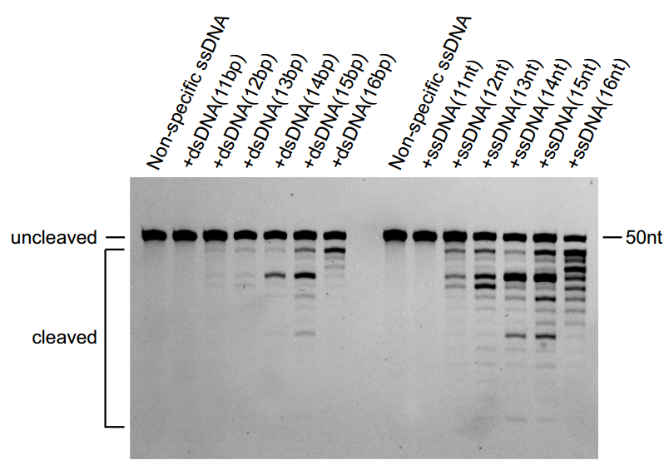
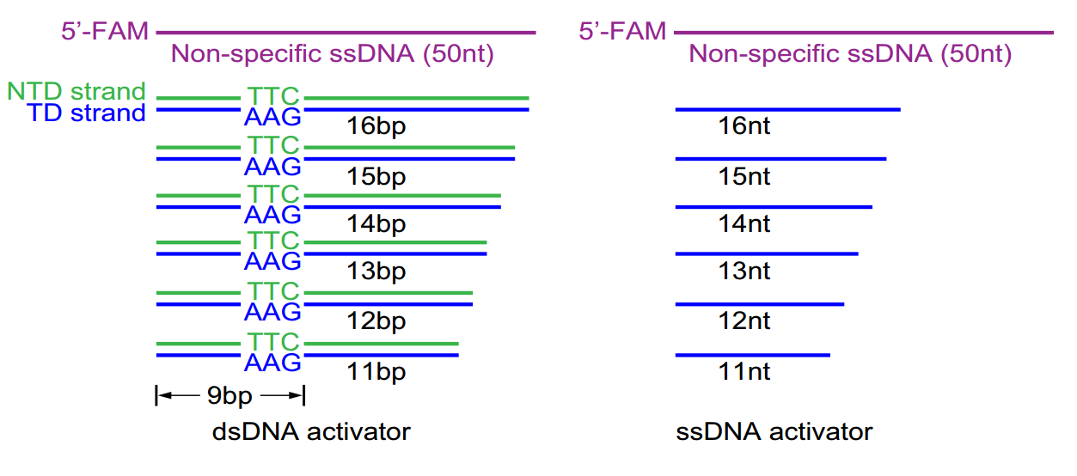
Target binding activates the Cas12i1 DNase activity
The results indicate that a 12-bp target dsDNA and a 12-nt target ssDNA can achieve detectable cleavage activity, whereas 14–16-bp target dsDNA and 13–16-nt target ssDNA can fully activate the enzyme

Slide 31
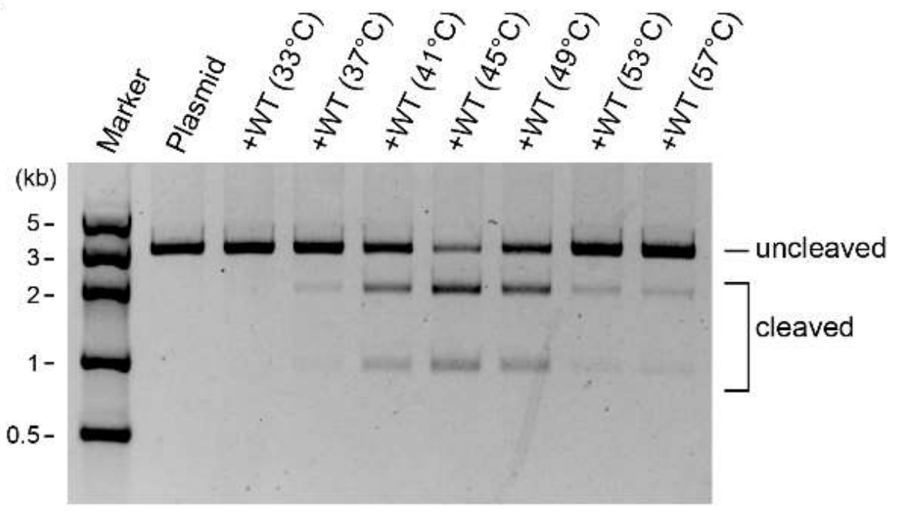
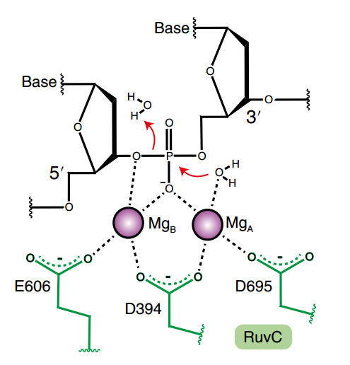
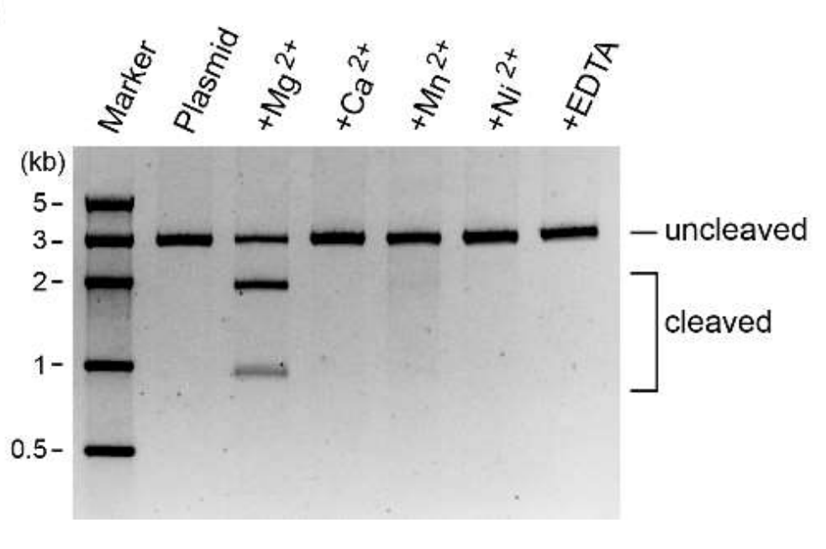
The temperature and metal-ion dependent
substrate cleavage

Slide 32
Discussion
Innovation point:
compare with previous work
Protein structure:
compared with homologous proteins
Application

Slide 33
Discussion
Innovation point: compare with previous work
1) The mechanism by which Cas12i unzips the double-stranded target duplex was short of investigation and information related to the R-loop formation and recognition in Cas12i was almost not reported
2) The NTD strand was successively cleaved 13–15 nucleotides after the PAM duplex, and the TD strand was cleaved 24 nucleotides after the PAM duplex
3) Due to the lack of the PI domain in the previously reported binary complexes of Cas12i1 and Cas12i2, the conformational movement of the PI domain was not observed

Slide 34
Discussion
Protein structure: compare with homologous proteins
1) Compare with Cas12i1, Cas12a, Cas12b, Cas12e
2) Compare with Cas9, TnpB (miss)
Application
1) Powerful tools for genome editing (miss): smaller and lower rate

Slide 35
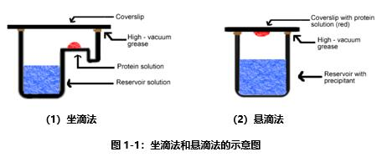
Methods
Purification of the Cas12i1 binary complex assembled in vivo
Formation of the Cas12i1 ternary complex
Purification of the uncomplexed Cas12i1 (not contain 2mM MgCl2): for use in the cleavage assays.
Crystallization: get a supersaturated solution
Data collection and structure determination
Site-directed mutagenesis
Assay
Reporting summary

Slide 36
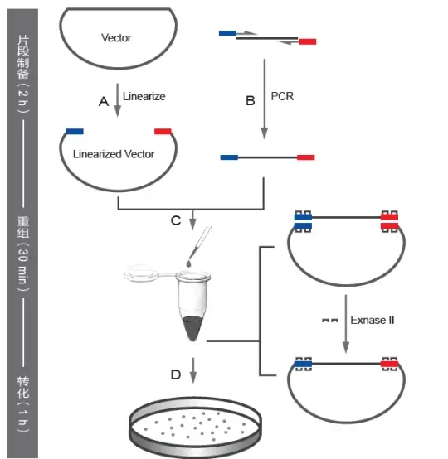
Methods
Homologous recombination

Slide 37
Q & A

Slide 38
Thanks
12111419 李政林
2023.06.25

